Slide 1
Cognitive: Basics Gary Wilson CTO & Technical Leader, UKI Commercial Business

Slide 2
Objective
Create a basic chatbot to help guide you when buying a new mobile phone
Watson Conversation
Node-RED
Web, Slack UIs

Slide 3
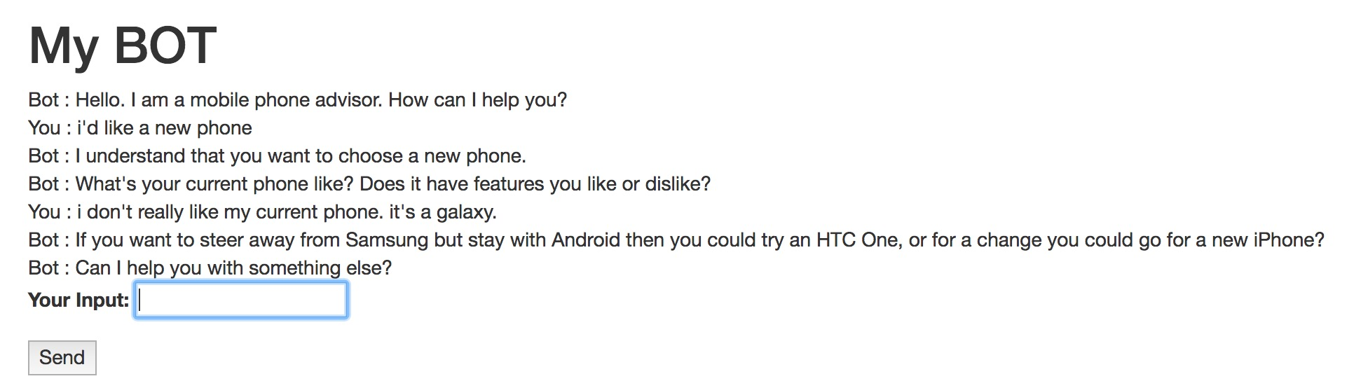
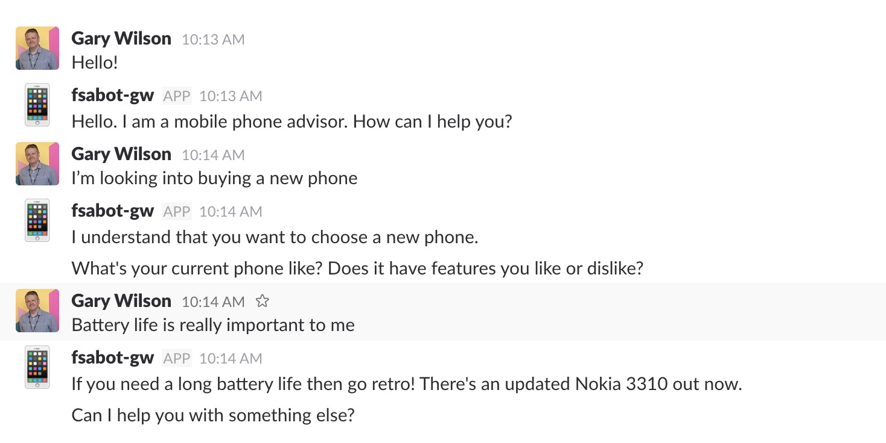
Objective

Slide 4

Agenda
Setup a Watson Conversation instance
Create intents, entities
Create dialog tree utilising both intents and entities
Setup a web-based UI and a Node-RED orchestration app
Create a Slack bot using the same conversation
install Slack node
setup Node-RED orchestration app

Slide 5
What is Watson Conversation?
Combines:
machine learning
natural language understanding
integrated dialog tools
… to create conversation flows between your apps and your users
Basic terms
Intent
Entity
Dialog

Slide 6
Intents and entities
Intents are a purpose or goal expressed by a user’s input
recognise user’s intent => choose the correct dialog flow / response
provide Watson Conversation with multiple examples (train)
Entities represent a class of object or a data type
can be used to trigger different responses, even for same intent
In our labs:
intents
newphone (‘I want to get a new phone’, ‘I’d like advice on a new mobile’,…)
positive (‘I like my Galaxy’, ‘I love my phone’, …)
negative (‘I don’t like my iPhone’, ‘I hate my mobile’, …)
entities
brand (Apple, Samsung, HTC, …)
parameter (style, battery, …)
Notes:
- Intents: recognising what the user is trying to do
- ... so we can provide an appropriate response
- Entities: a class of objects we can use to trigger different responses, even for the same intent
- e.g. mobile phone brands

Slide 7
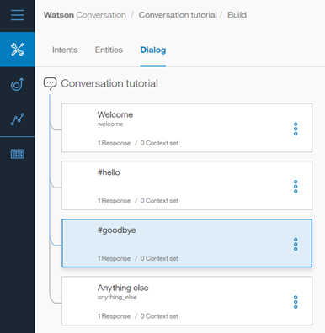
Dialog
Defines the flow of your conversation in the form of a logic tree
Each node of the tree has a condition that triggers it, based on user input
Uses intents and entities
Interacts with the user and provides a response

Slide 8
Development
How to use Conversation API:
Curl based API
Download and install programming language API
Node SDK - https://github.com/watson-developer-cloud/node-sdk
Java SDK - https://github.com/watson-developer-cloud/java-sdk
Python SDK - https://github.com/watson-developer-cloud/python-sdk
iOS SDK - https://github.com/watson-developer-cloud/swift-sdk
Unity SDK - https://github.com/watson-developer-cloud/unity-sdk
Node-RED

Slide 9
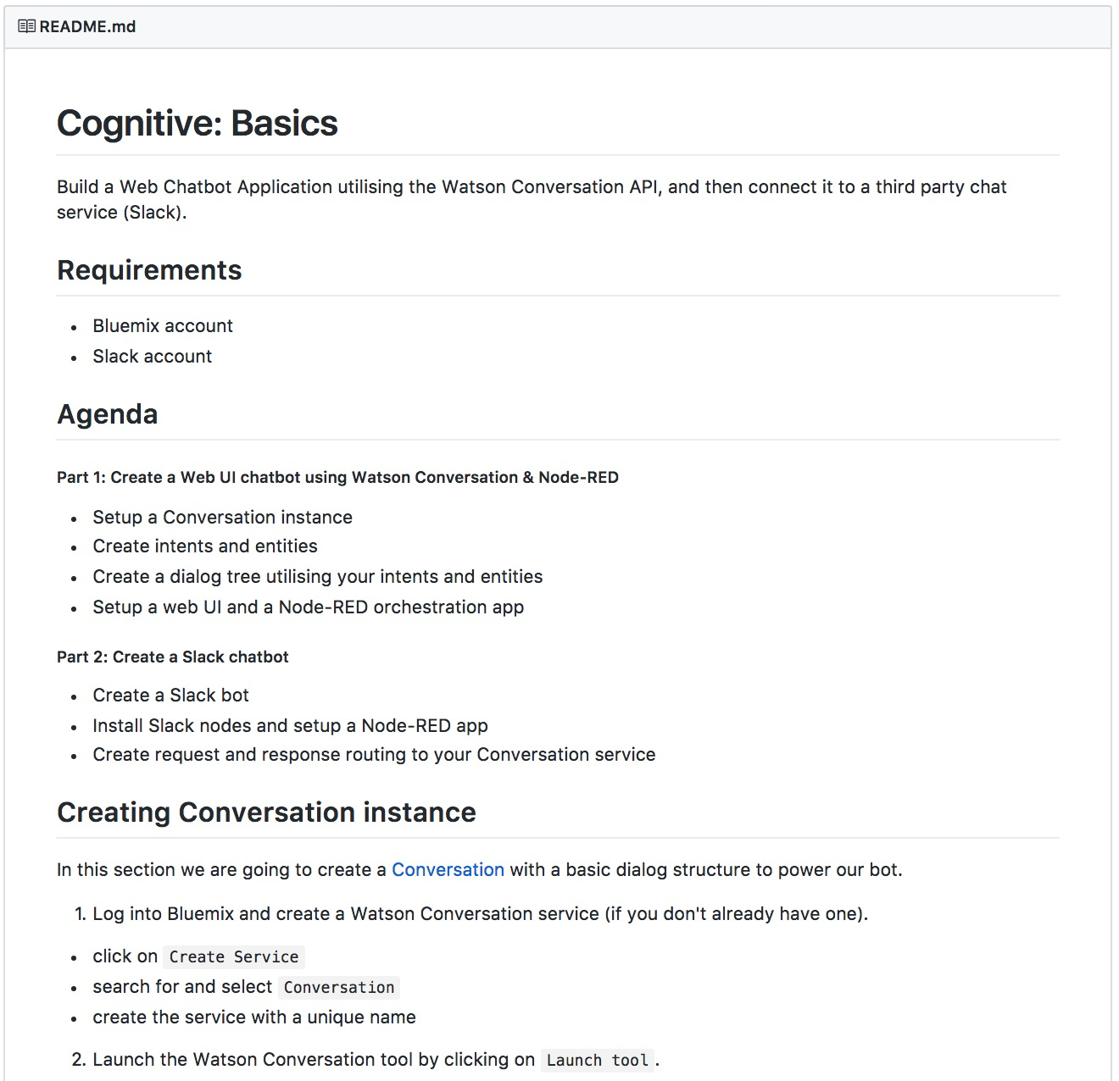
Lab format
Step-by-step instructions
GitHub README.md for each lab
Work at your own pace
ibm.biz/cognitivelabs
Notes:
https://github.ibm.com/gary-wilson/Cognitive-Labs-v3

Slide 10
Cognitive: Basics Gary Wilson CTO & Technical Leader, UKI Commercial Business

